Slide 1


UNIVERSITY OF THE PELOPONNESE – FACULTY OF ENGINEERING
ELECTRICAL & COMPUTER ENGINEERING DEPARTMENT
DIPLOMA THESIS
EEG-based Connectivity Analysis for Differentiating
Alzheimer's Disease and Frontotemporal Dementia.
STUDENT : KARADIMITROPOULOU MARIA
AM : 20121
SUPERVISOR PROF. : KOUTRAS ATHANASIOS
DATE : 24/10/2025
PLACE : PATRAS

Slide 2

Table of Contents
Introduction
Theoretical Background
EEG Basics
Preprocessing
Feature Extraction
Machine Learning Approach
CNN Basic Architecture
Results
Data
CNN Advanced Architecture
EEG Topographic Maps: Group Differences
Which Model performance wins?

Slide 3





Introduction
According to the World Health Organization (WHO), more than 55 million people are currently living with dementia worldwide.
A number projected to rise to 78 million by 2030 and 139 million by 2050.
Alzheimer’s disease (AD) is the most prevalent, accounting for 60–80% of all cases globally.
Frontotemporal dementia (FTD) represents approximately 10% of cases.
In response to these challenges, the WHO has recognized dementia as a public health priority, advocating for heightened global awareness, preventive strategies, and improve early diagnosis and care services .
Early and accurate diagnosis is critical for timely intervention and effective care planning.

Slide 4


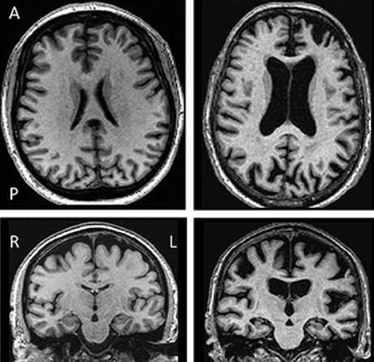
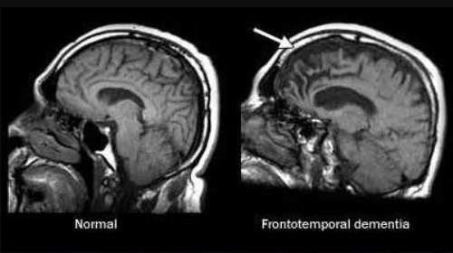

Theoretical Background
Alzheimer Disease
AD primarily affects memory and cognitive functions, beginning with memory loss and progressing to severe confusion and disorientation.
Frontotemporal Dementia
FTD primarily affects behavior, personality, and language, often appearing earlier in life (before age 65).
It is marked by the buildup of amyloid plaques and tau tangles in the brain, leading to neuronal death, particularly in the hippocampus.
It results from the degeneration of the frontal and temporal lobes due to abnormal proteins like tau, TDP-43, and FUS, causing dramatic personality and emotional changes.
AD
Patient
Healthy
Patient

Slide 5

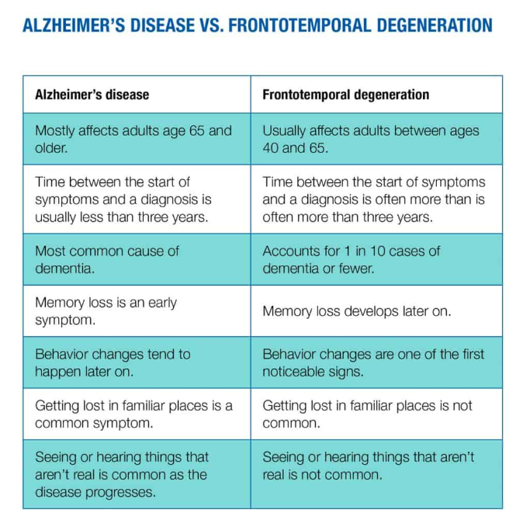
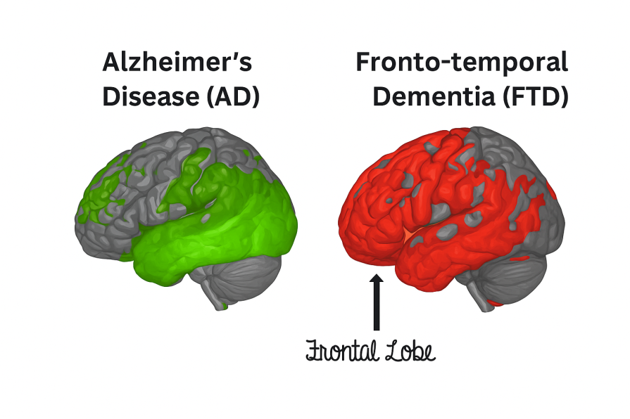
Risk Factors
Early Signs & Symptoms
Age 65+ is the strongest risk factor
Hypertension, diabetes, obesity
Smoking, alcohol overuse, inactivity
Air pollution and poor lifestyle habits
Social isolation and depression
Memory loss and confusion in familiar places
Misplacing items or getting lost easily
Trouble making decisions or solving problems
Difficulty communicating or finding words
Mood and personality changes, social withdrawal
Differences Between AD vs FTD

Slide 6
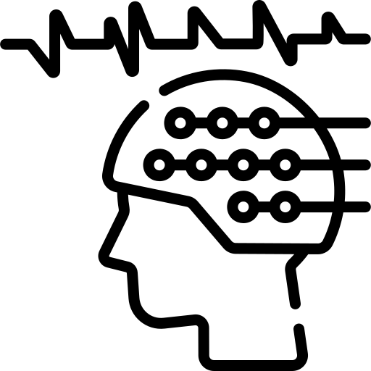
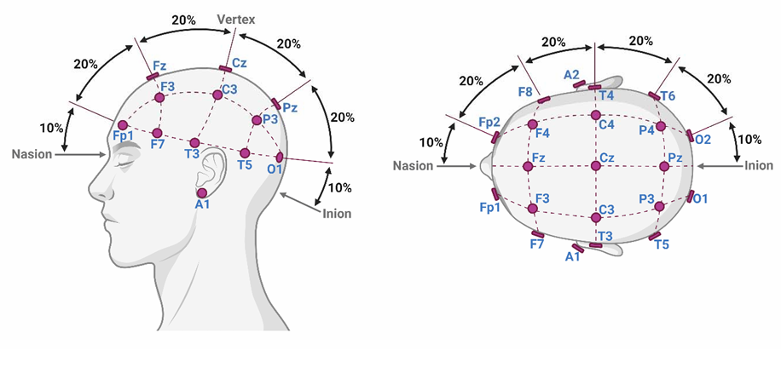
EEG Basics
What is EEG?
Electroencephalography (EEG) records brain activity through scalp electrodes.
It measures electrical signals produced by synchronized neuron firing.
Non-invasive, portable, inexpensive, and provides millisecond-level temporal resolution.
Why EEG for Dementia?
Detects functional (not structural) brain changes, revealing neural network disruptions.
Identifies early abnormalities before structural atrophy appears on MRI/CT.
Useful for tracking disease progression and evaluating treatment response.
EEG Setup
Uses the 10–20 international system for electrode placement.
Covers frontal (F), central (C), parietal (P), temporal (T), and occipital (O) brain regions.
Left hemisphere = odd numbers
Right = even numbers
Midline = “z”

Slide 7

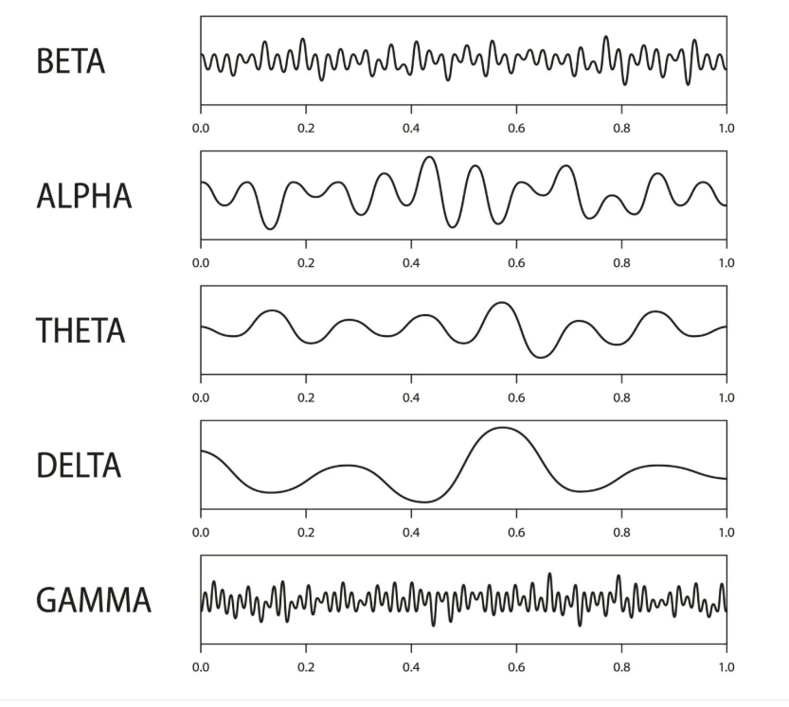
EEG results provide important information about the brain’s electrical activity across different frequency bands
Band | Frequency (Hz) | Functional Role
Delta (δ) | 0.5 - 4 | Deep sleep, brain injury markers
Theta (θ) | 4 - 8 | Memory, drowsiness, early AD signs
Alpha (α) | 8 - 13 | Relaxed wakefulness, reduced in AD/FTD
Beta (β) | 13 - 25 | Active thinking, reduced in dementia
Gamma (γ) | 25 - 45 | High cognition, disrupted in dementia
AD: Reduced alpha/beta power, increased delta/theta slowing — posterior brain disruption.
FTD: Frontal alpha reduction and localized delta increases — anterior brain dysfunction.

Slide 8

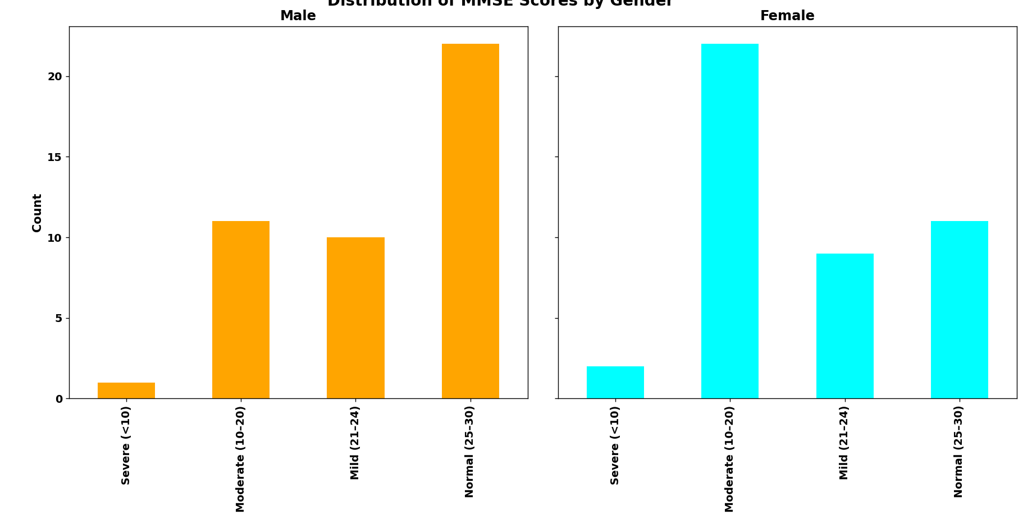
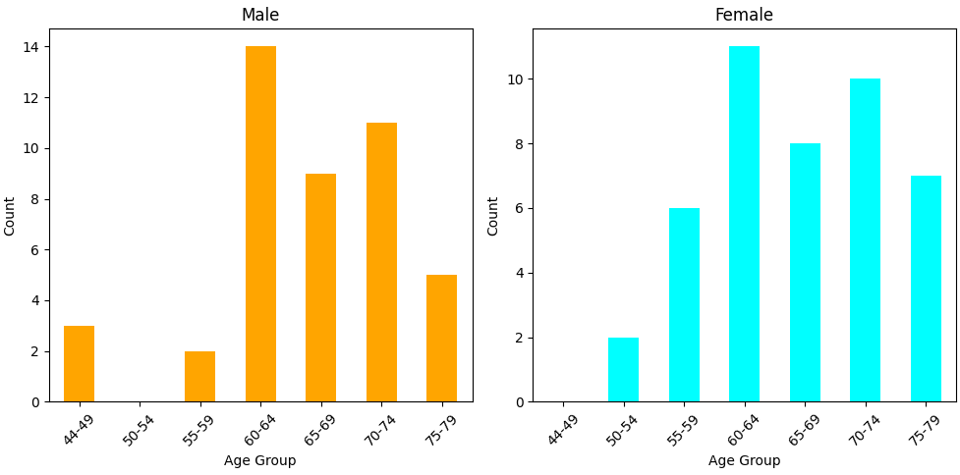
Data
The study uses a publicly available EEG dataset from Greek researchers with 88 participants (OpenEuro):
36 with Alzheimer's disease (AD)
23 with Frontotemporal Dementia (FTD)
29 healthy controls (CN)
EEG recordings were conducted using 19 scalp electrodes adhering to the 10–20 system during eyes-closed resting state sessions
AD group: Mean age 66.4, mostly female
FTD group: Mean age 67.9
Each participant completed the MMSE cognitive assessment: AD mean score ~18 FTD ~21, CN ~29
Total EEG recording time:
485 min (AD)
276 min (FTD)
402 min (CN)

Slide 9

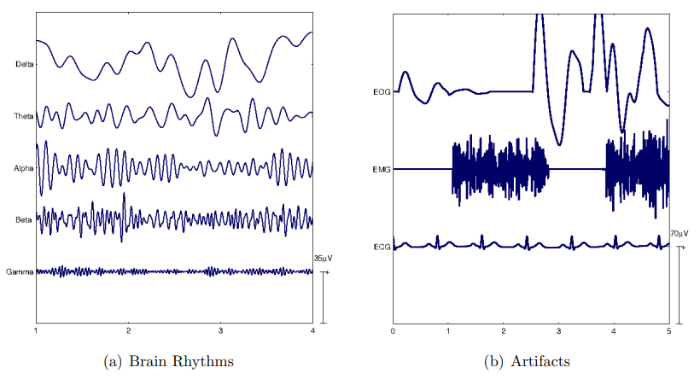

Preprocessing
Data sourced from derivatives folder (pre-prepared files)
Butterworth band-pass filter (0.5–45 Hz) applied
Signals re-referenced to average of A1 & A2 electrodes
Artifact reduction via Automatic Subspace Reconstruction (ASR)
Window: 0.5 s, SD threshold: 17
Independent Component Analysis (ICA) using RunICA algorithm
19 channels → 19 independent components
Eye/jaw artifacts auto-rejected via ICLabel (EEGLAB)
Even with eyes closed, residual eye movement artifacts were detected
EOG (eye)
EMG (muscle)
ECG (cardiac)

Slide 10

Feature extraction
Spectral Domain
Computed using Welch’s method
Complexity Domain
Capture
Functional Connectivity
Quantifies synchronization across EEG channels
Time Domain
δ (0.5–4 Hz), θ (4–8 Hz), α (8–13 Hz), β (13–25 Hz), γ (25–45 Hz)
Relative Band Power (RBP): $RBP=P_{band}/P_{total}$
Relative Band Power (RBP): 𝑅𝐵𝑃=𝑃_𝑏𝑎𝑛𝑑/𝑃_𝑡𝑜𝑡𝑎𝑙
Key Ratios:
Alpha/Theta
Beta/Theta
executive
Function
attention,
arousal
performance
cognitive
EEG frequency bands:
Capture
Basic statistics
Additional features:
Zero-Crossing Rate Root Mean Square Peak-to-Peak Amplitude
signal amplitude, morphology, variability
Mean, SD, Variance, Skewness, Kurtosis
Hjorth Parameters:
Mobility
Complexity
Approximate Entropy (ApEn)
Sample Entropy (SampEn)
irregularity and unpredictability of EEG signals
= more complex neural activity
Computed
Connectivity metrics per channel:
Mean, Median, SD, Maximum, 90th Percentile
Strong Connection Ratio (|r| > 0.5)
Reflects
via Pearson correlation between channels
network-level coupling and integration
Entropy Measures:
Mean Absolute Deviation
→ Higher entropy
Final feature set (~266 per channel):
a)49 Spectral b)63 Time-domain c)28 Nonlinear d)6 Connectivity

Slide 11

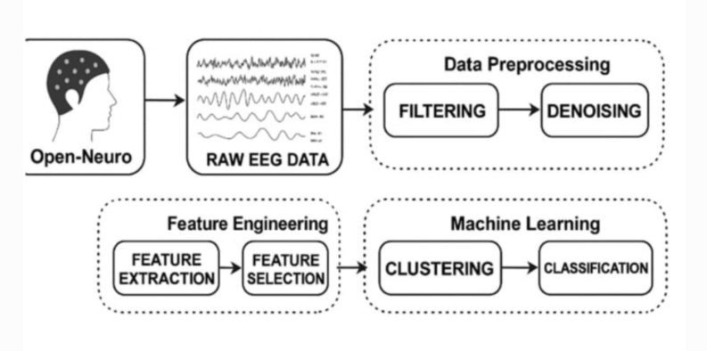


Machine Learning
Machine Learning Algorithms
Support Vector Machines (SVMs): Utilized both linear and RBF kernels to capture linear and nonlinear separability in high-dimensional EEG feature space.
Linear Discriminant Analysis (LDA): Employed for interpretable classification by maximizing class separability through linear discriminant functions with shrinkage regularization.
Gaussian Naive Bayes (GNB): Probabilistic model assuming feature independence; provides fast, stable classification for high-dimensional EEG data.
Random Forest (RF): Ensemble of 200 decision trees with class-balanced weighting and depth limitation (max depth = 5) to control overfitting and enhance generalization.
Performance Evaluation Metrics
Accuracy – overall correct predictions
Balanced Accuracy – adjusts for class imbalance
Specificity – true negative rate
F1-Score – harmonic mean of precision & recall
ROC & AUC – measure separability; higher = better
Confusion Matrix – visualize classification outcomes
For multi-class → One-vs-Rest AUC averaging
Cross-Validation Strategy
Leave-One-Out Cross-Validation (LOOCV) → robust for 88-subject dataset
Oversampling applied only to training folds → balance classes without data leakage
Ensures fair, unbiased model evaluation
Libraries:
scikit-learn – ML algorithms, feature selection, metrics
MNE, Pandas, NumPy – EEG processing & data handling
Matplotlib, Seaborn – visualization (ROC, confusion matrices)

Slide 12

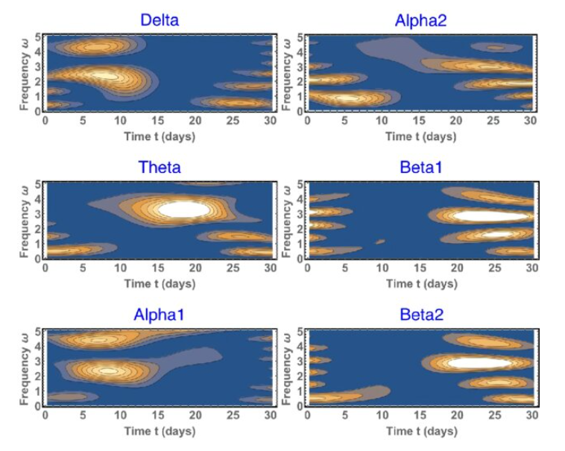
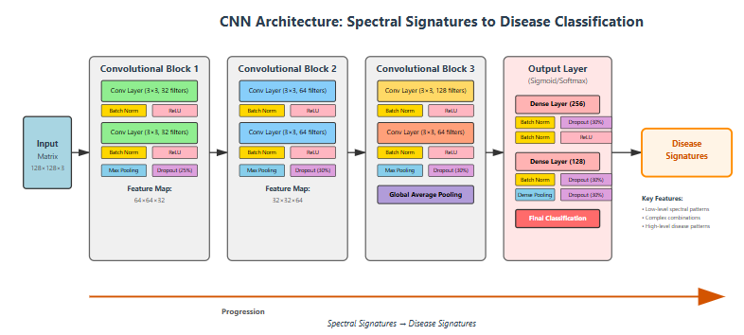
CNN Basic Architecture
Architecture
3 Convolutional Blocks (filters = 32 → 64 → 128)
Batch normalization, ReLU, Max Pooling, Dropout (25–30%)
Global average pooling → Dense layers (256, 128 units) → Output (Softmax/Sigmoid)
Purpose: Baseline for performance comparison with advanced model
Data Representation
EEG → 2D spectrograms (2 s windows, 50% overlap)
Two spectrogram strategies:
Multi-Channel: Each electrode processed independently (0.5–45 Hz)
Spatial Spectrogram: Electrodes mapped to 5×5 grid (10–20 system, Gaussian interpolation)

Slide 13
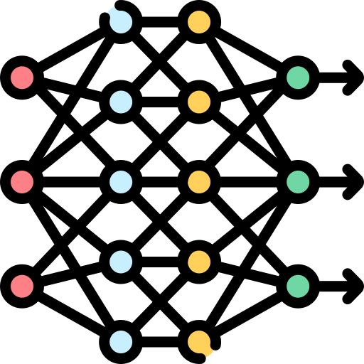
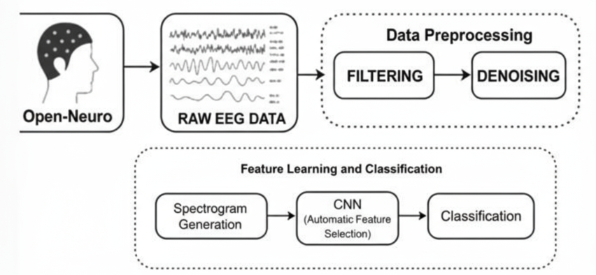
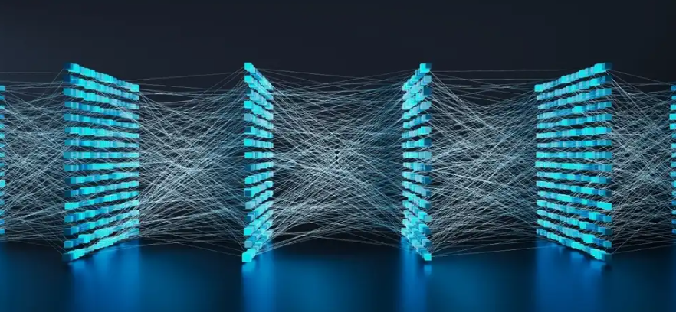

CNN Advanced Architecture
a) Enhanced Input Representation
EEG spectrograms: Multi-Channel, Spatial, Frequency-Band, or Hybrid
Window length: 4 s, Overlap: 75%
Expanded 8×5 electrode grid for improved anatomical resolution
b) Hierarchical Convolutional Architecture
3 Convolutional blocks: 32 → 64 → 128 filters
Each block: Convolution → BatchNorm → ReLU → MaxPooling → Dropout
c) Dense Layers & Classification
Dense layers: 256 → 128 units with BatchNorm and Dropout
Output: Sigmoid (binary) / Softmax (multi-class)
d) Regularization & Optimization
Focal loss to address class imbalance
L2 weight regularization, dropout, and batch normalization
Key Advantages
Captures longer temporal dependencies and richer spectral features
Handles multiple EEG input strategies simultaneously
Robust to noise and inter-subject variability

Slide 14

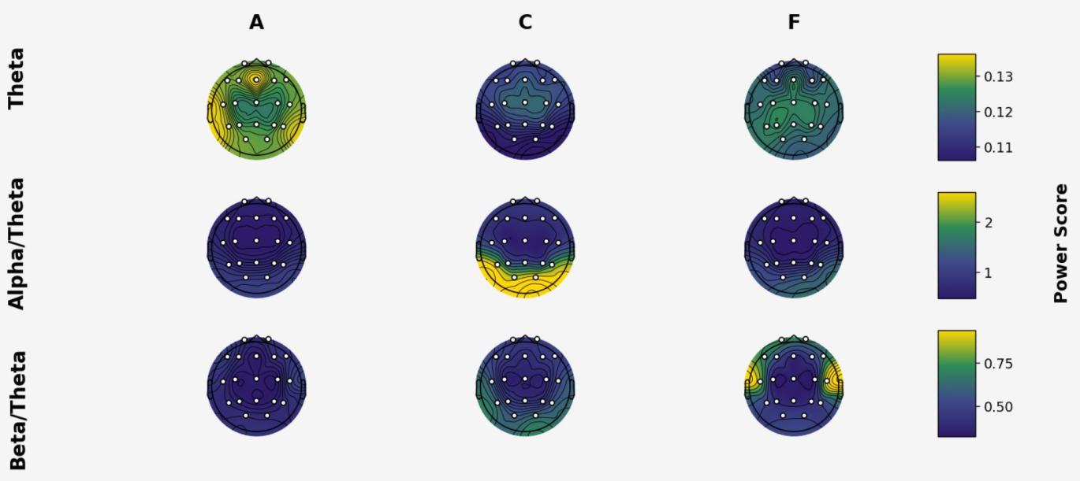

EEG Topographic Maps: Group Differences
Visual summary: Topographic EEG maps show where brain rhythms differ across groups—Alzheimer’s Disease (AD), Controls (CN), and Frontotemporal Dementia (FTD).
Theta Power (4–8 Hz):
AD: Markedly increased frontal‑central theta—signals abnormal slow-wave activity.
Controls & FTD: Lower frontal theta—normal.
Takeaway: High frontal theta often signals AD.
Alpha/Theta Ratio:
Controls: High at the back (posterior)—shows normal brain rhythm.
AD & FTD: Reduced, evenly spread ratio—suggests less alpha, more theta.
Takeaway: Low ratio may indicate dementia.
Beta/Theta Ratio:
FTD: High in both temporal lobes—specific to FTD.
AD: Low overall—shows strong theta, weak beta.
Takeaway: High temporal beta/theta helps spot FTD
Beta/Theta Ratio:
FTD: High in both temporal lobes—specific to FTD.
AD: Low overall—shows strong theta, weak beta.
Takeaway: High temporal beta/theta helps spot FTD.
Why topomaps matter: They make region‑specific changes in brain activity visible, helping identify distinctive EEG biomarkers for clinical diagnosis.

Slide 15
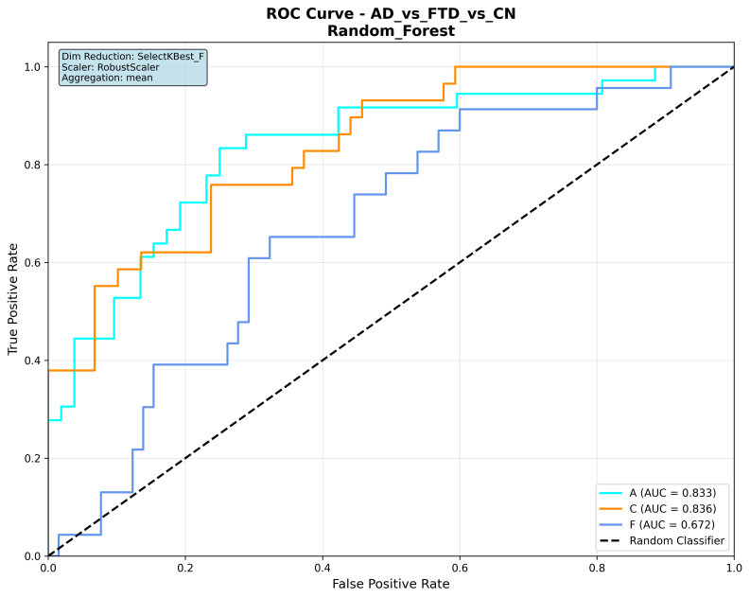
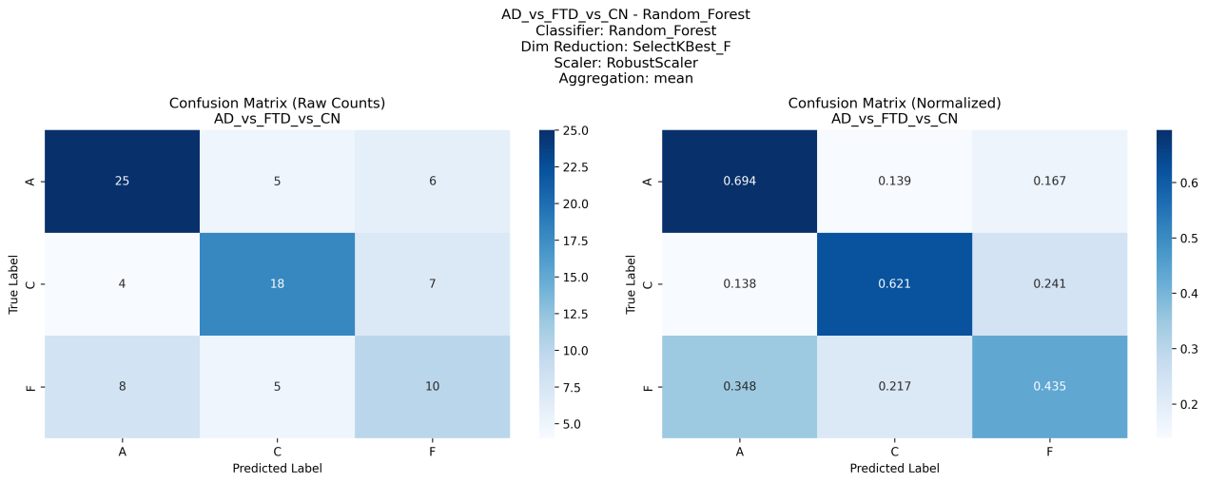
Machine Learning Results
Task | Classifier | Dim_Reduction | Accuracy | Balanced Accuracy | Specificity | F1 Score | AUC | N_Samples
AD vs FTD | SVM_linear | None | 0.661 | 0.636 | 0.75 | 0.658 | 0.638 | 59
AD vs CN | Random Forest | None | 0.815 | 0.810 | 0.861 | 0.815 | 0.876 | 65
CN vs FTD | Random Forest | Variance Threshold | 0.769 | 0.766 | 0.793 | 0.769 | 0.772 | 52
AD vs FTD vs CN | Random Forest | SelectKBest_F | 0.614 | 0.599 | 0.807 | 0.616 | 0.762 | 88

Slide 16
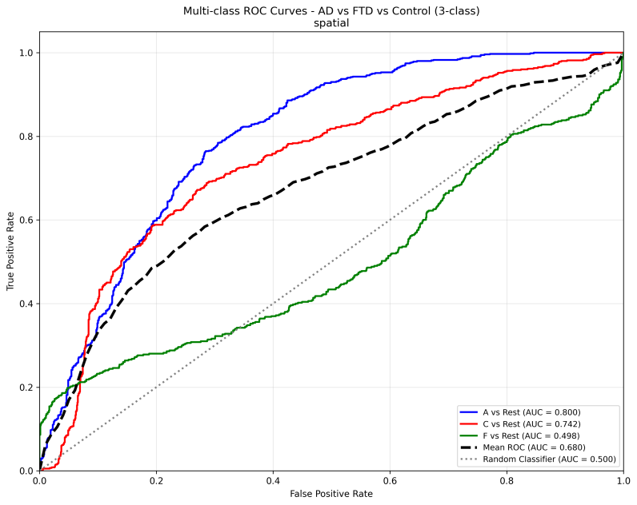
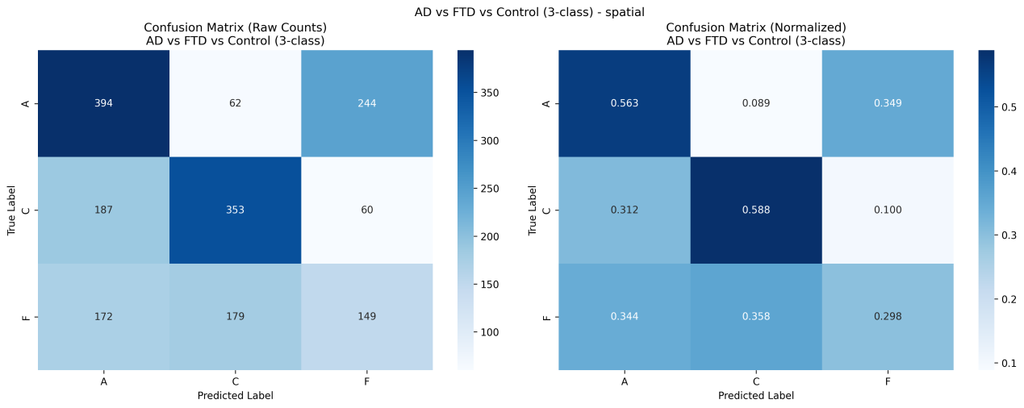
Basic CNN Results
Task | Method | Accuracy | Balanced Accuracy | Specificity | F1 Score | AUC
AD vs_FTD | Multi_Channel | 0.601 | 0.525 | 0.525 | 0.433 | 0.705
AD vs CN | Multi_Channel | 0.733 | 0.728 | 0.728 | 0.729 | 0.769
CN vs FTD | Multi_Channel | 0.685 | 0.684 | 0.684 | 0.683 | 0.703
AD vs FTD vs CN | Spatial | 0.498 | 0.483 | 0.746 | 0.482 | 0.678

Slide 17
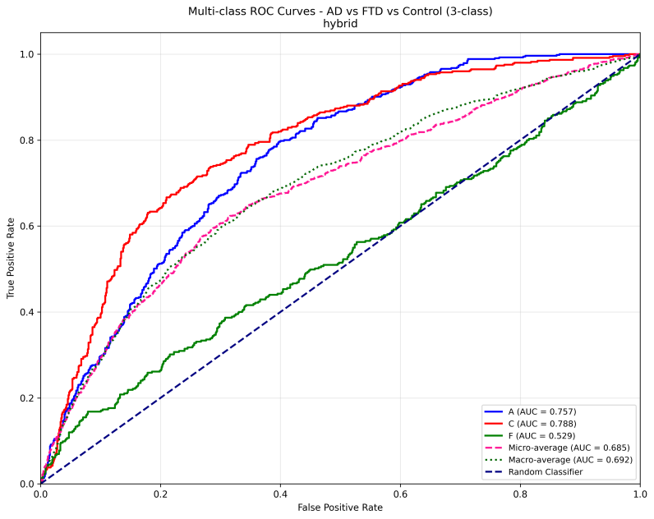
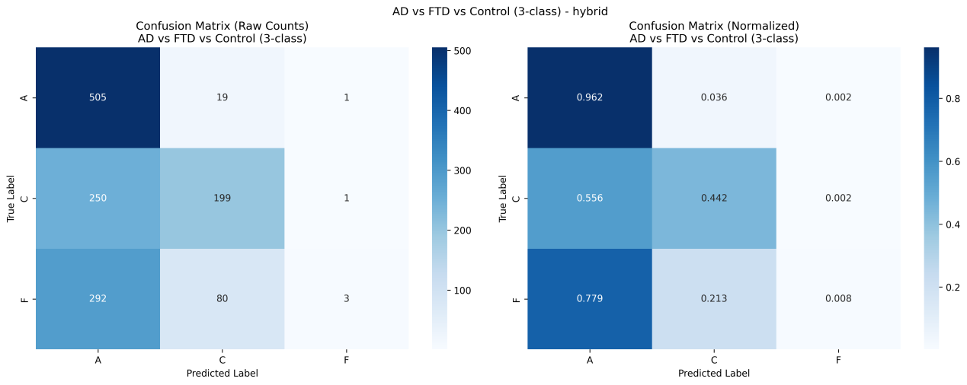
Advanced CNN Results
Task | Method | Accuracy | Balanced Accuracy | Specificity | F1 Score | AUC
AD vs FTD | Hybrid | 0.587 | 0.506 | 0.992 | 0.036 | 0.497
AD vs CN | Hybrid | 0.704 | 0.714 | 0.577 | 0.726 | 0.775
CN vs FTD | Multi_Channel | 0.632 | 0.639 | 0.556 | 0.641 | 0.703
AD vs FTD vs CN | Hybrid | 0.524 | 0.471 | 0.744 | 0.397 | 0.691

Slide 18


Which Model performance wins?
Why Traditional ML outperformed
Reasons:
Limited dataset size → CNNs need more data to generalize effectively.
EEG variability & noise → end-to-end learning is challenging; handcrafted features help.
ML advantages: Random Forests, SVMs efficiently use physiologically meaningful features; more stable and interpretable.
Ensemble & kernel methods → better handle small, imbalanced, or noisy datasets.
Conclusion:
Classical ML is better suited for current EEG-based dementia classification.
CNNs may perform better with larger datasets, advanced architectures, and data augmentation.
AD vs FTD
Best Method: SVM_linear (Machine Learning)
Performance:
Accuracy = 0.661, AUC = 0.638
This outperforms both the basic and advanced CNN approaches for this task.
AD vs CN
Best Method: Random Forest (Machine Learning, no dimensionality reduction)
Performance:
Accuracy = 0.815, AUC = 0.876
This is higher than both basic and advanced CNN models.
CN vs FTD
Best Method: Random Forest + Variance Threshold
(Machine Learning)
Performance:
Accuracy = 0.769, AUC = 0.772
This method produced better results than both CNN approaches for this comparison.
AD vs FTD vs CN (Multi-class)
Best Method: Random Forest + SelectKBest_F (Machine Learning)
Performance:
Accuracy = 0.614, AUC = 0.762
Again, this outperforms the CNN-based approaches.

Slide 19

“Our memories are what make us who we are; without them, we are like a book with its pages torn out.”
Dr. Kay Redfield Jamison

Slide 20


